Slide 1
ONLINE INTERNSHIP

Slide 2
ABSTRACT
Internship process for students is web application it helps to process internship work through online. An internship experience combines hands-on workplace experience with your discipline-specific skills, and earns academic credit towards your course. Arranging your internship involves three steps: preparing, securing, and registering. An internship experience combines hands-on workplace experience with your discipline-specific skills, and earns academic credit towards your course. Arranging your internship involves three steps: preparing, securing, and registering.
As the Internship in Online accessibility software, “ONLINE INTERNSHIP” has helped students to view the company’s availability of vacancies in internship, how to apply the procedure and techniques details are easily track through this website process, and also they check of interviews available for internship, company can post their requirement.
This project is aimed at developing by using JAVA as Front end and MySQL Server as Back end.

Slide 3
HARDWARE SPECFICATION
System : Pentium IV 2.4 GHz.
Hard Disk : 180 GB.
Floppy Drive : 1.44 Mb.
Ram : 8 GB.

Slide 4
SOFTWARE SPECIFICATION
Operating system : Android.
Front End : JAVA
Back End : MYSQL

Slide 5
EXISTING SYSTEM
In existing system there is an no proper way to communicate with client and the internship students. Students they need to search the job or intern by themselves. Which is more complex to find the opportunity to prove our knowledge
DISADVANTAGES
Complex to managing the internship process.
Due to that they face problems like data loss.
Can’t follow the up-to-date status of the project.

Slide 6
PROPOSED SYSTEM
This new interface shall enable the students to apply for internship. To use this system, the students should have registered with the database. Each student shall have a login id and password. The admin shall have the rights to create and manage these users from the back end. When the students log in to the system, a grid view shall be displayed which displays all the open job positions. It also gives the details about the start and end date. It gives a brief description about the job. Using the apply button the student shall be able to apply for the job.

Slide 7
ADVANTAGES
Very easy to understand the flow of project structure.
Could be gave more opportunity to the student
Easy to track the intern students

Slide 8
Modules
Admin Login
This module admin can able login into the application and perform an action to managing the student project tracking. Admin can have all the access to do the bellowed modules activities.
Student Registration Form
This module admin collects the all the information from the student and stored into the student table. Student table have all the requested field to map the application. Once the student has a mapped before should create the registration form.

Slide 9
Project Allocation
Admin compare the technology wise student to allocate the student to the particular project. Once all the students are allocating into the particular project their list will be showing into the project status window.
Student Details
Here we can able view the all the student details and allocating project details as well. A cumulative report can we collect here for the user. We can check the student count and student project details.
Pending & completed project status
This module will show the user for displaying the pending and completed project details. Admin can easily check the current status of the all the project in a single window.

Slide 10

Data Flow Diagram
Level 0

Slide 11
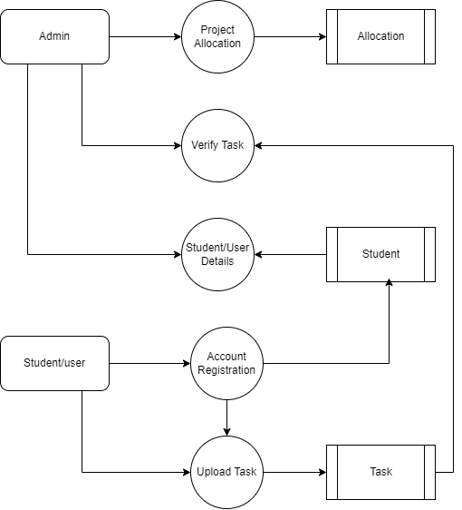
Level 1:

Slide 12
TABLE DESIGN TABLE NAME:ADMIN
FIELD | DATA TYPE | SIZE | CONSTRAINT
Admin id | Int | 10 | Primary key
Username | Varchar | 30 | Not null
password | Varchar | 30 | Not null

Slide 13
TABLE NAME:Student
FIELD NAME | FIELD TYPE | SIZE | CONSTRAINT
Id | Int | 10 | Primary key
Applicant_name | Varchar | 15 | Not null
Qualification | Varchar | 15 | Not null
Mobile | Varchar | 15 | Not null
Front end | Varchar | 15 | Not null
Back end | Varchar | 15 | Not null
Database | Varchar | 15 | Not null
Designation | Varchar | 15 | Not null
Username | Varchar | 15 | Not null
Password | Varchar | 15 | Not null

Slide 14
TABLE NAME:Task
FIELD NAME | FIELD TYPE | SIZE | CONSTRAINT
Id | Int | 10 | Primary key
Title | Varchar | 30 | Not null
Description | Varchar | 100 | Not null
Front end | Varchar | 15 | Not null
Back end | Date | 20 | Not null
Modules | Varchar | 100 | Not null

Slide 15
TABLE NAME:Allocation
FIELD NAME | FIELD TYPE | SIZE | CONSTRAINT
Id | Int | 10 | Primary key
Project id | Int | 10 | Foreign key
Student id | Int | 10 | Foreign key
Code | Varchar | 10000 | Not null
date | Date | 10 | Not null

Slide 16
Thank You

